Slide 1
DATA ANALYSIS

Slide 2
Connecting Parameters to Actual Data
 | Analysis Parameter | Indicator
1. | Proximity to CBD and Train Station | Calculated distance based on latitude and longitudinal position
2. | Earnings | Price/Day/Person
3. | Popularity of areas (Occupancy) | Reviews/month
4. | Neighborhoods | Suburbs names with more than 20 listings

Slide 3
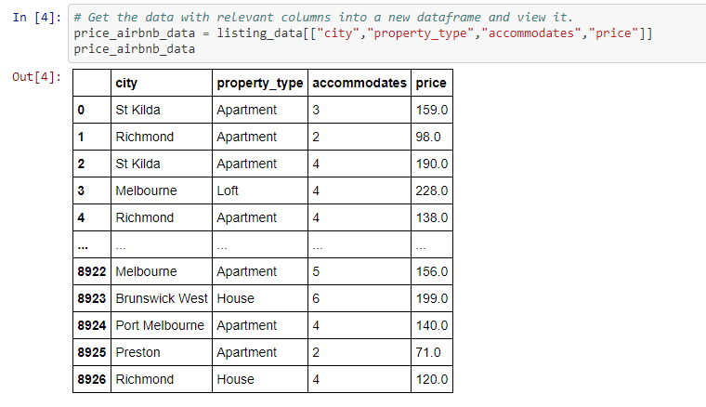
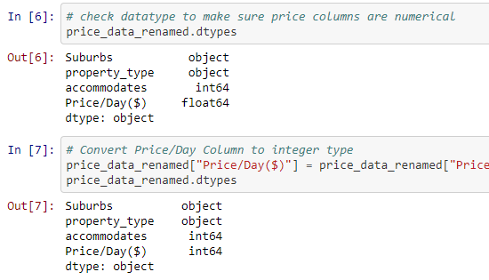
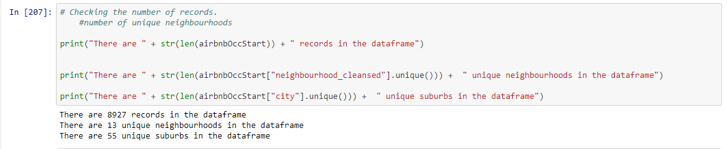
STEP 1: Filter for relevant columns: city, suburb, property type, price/day and study overall data information

Slide 4
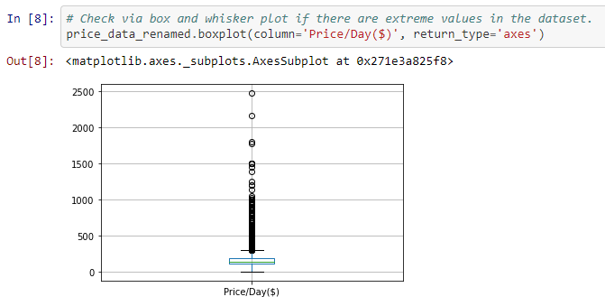
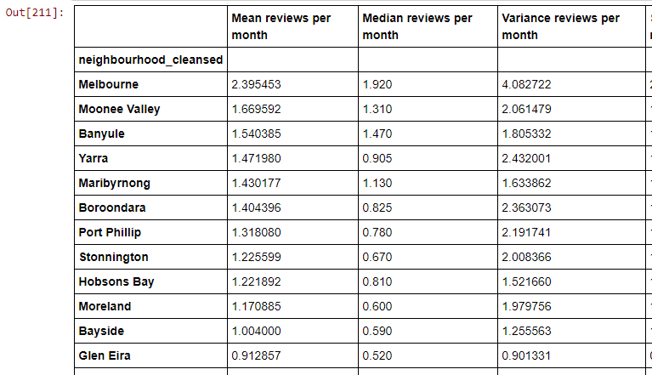
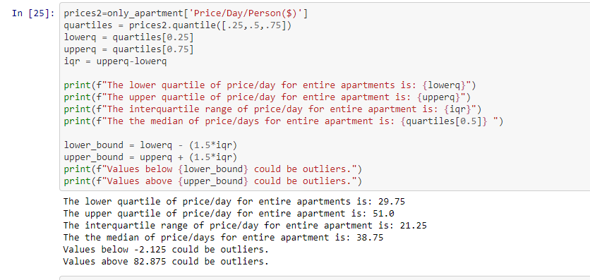
STEP 2: Statistical Analysis for checking data quality and take decisions on further filtering

Slide 5
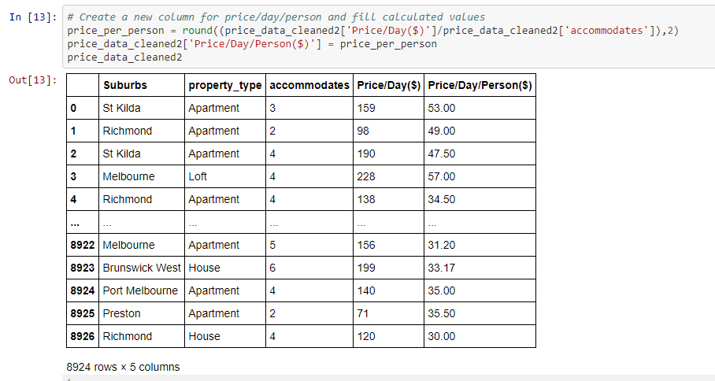
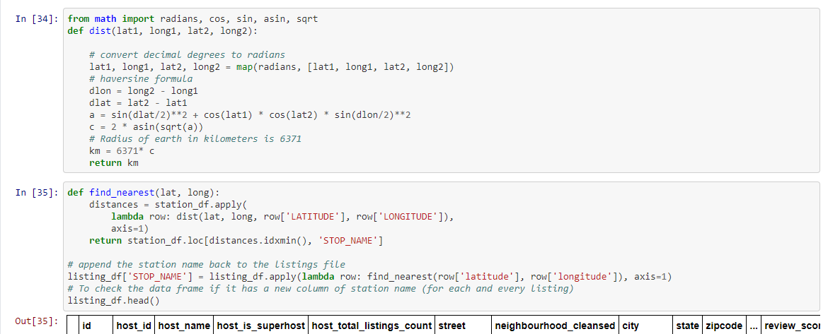
STEP 3: Perform required calculations .

Slide 6
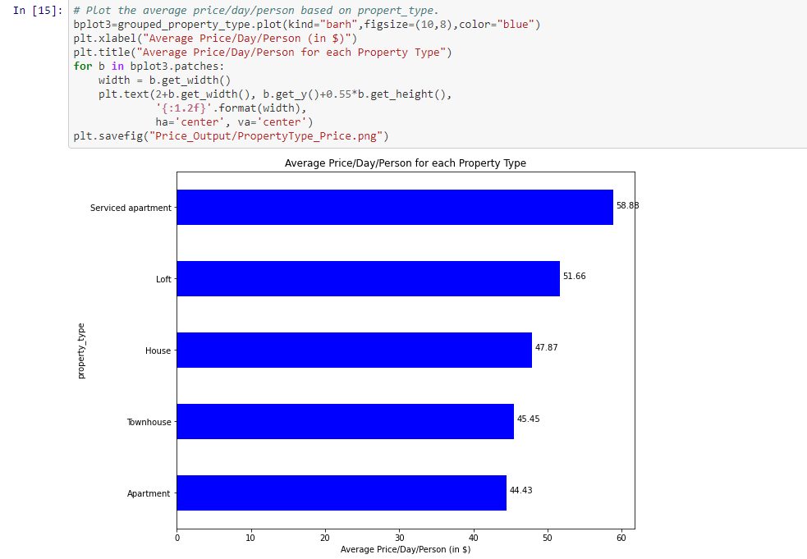
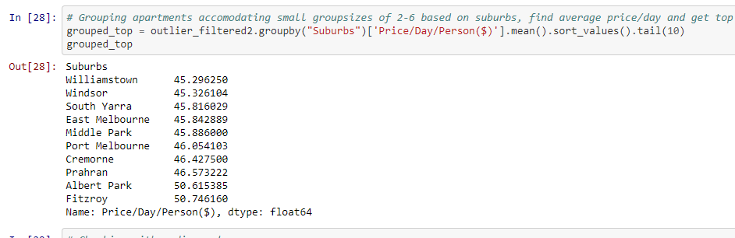
STEP 4: Group by parameters like apartment type and suburbs to study their effect..

Slide 7
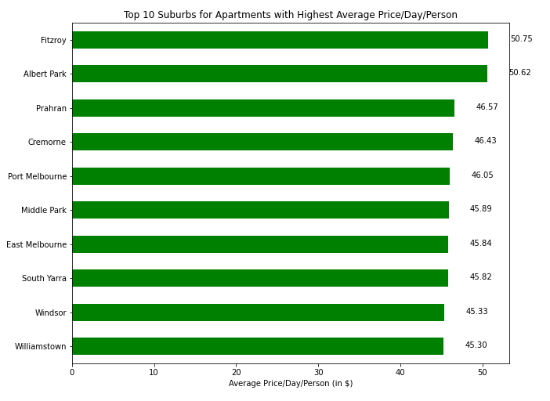
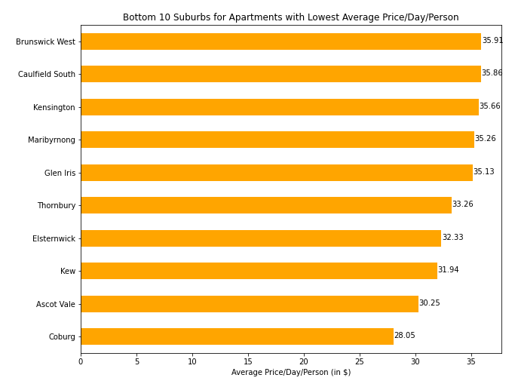
STEP 5: Rank by suburbs to analyse the top 10 and bottom 10 suburbs for our focus areas.

Slide 8
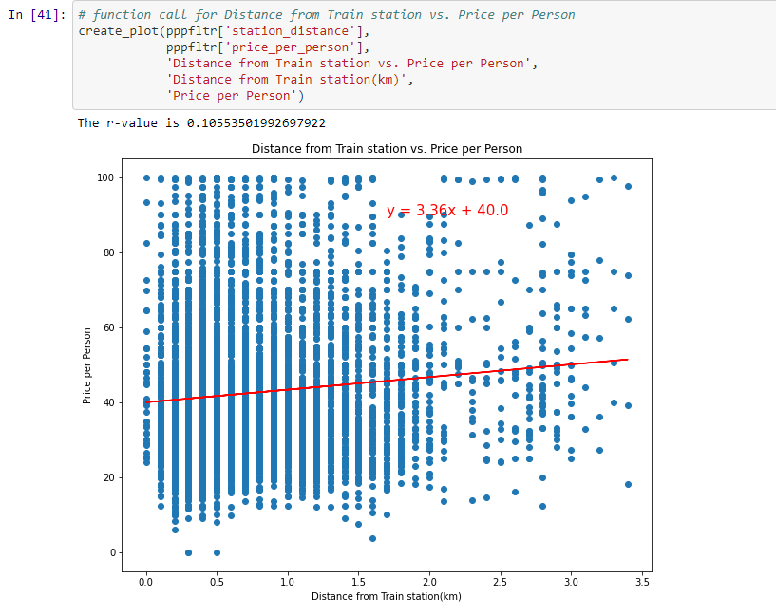
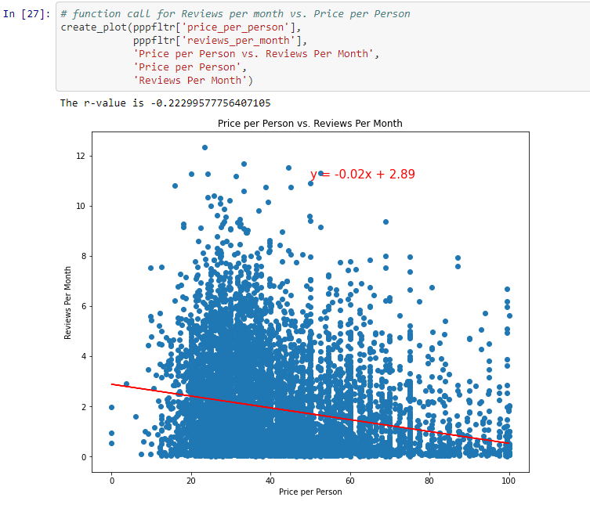
STEP 6: Use scatter plots and linear regression to establish correlation for our hypothesis.

